Slide 1
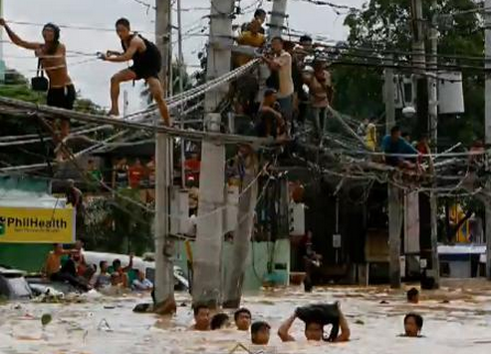
The Filipino Mind Revolution
Tired of Pinoy Corruption and Incompetence?
REALLY???
Go For
zaxxun.com/filipino_mind_revolution
picking up where Noli Me Tangere and El Filibusterismo left off

